Slide 1
Forces in One Dimension

Slide 2

In this Smart Lesson you will learn to:
Construct free-body diagrams representing forces acting on an object in one dimension.
Determine the resultant force acting on an object in one dimension.

Slide 3
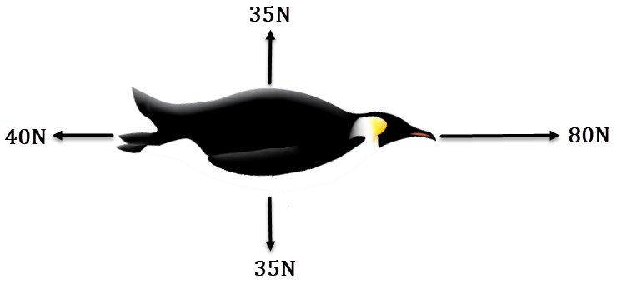
Free body diagrams show all the forces acting on an object.
They are represented as arrows pointing in the direction the force acts.
The length of the arrow represents the magnitude of the force.
For example:

Slide 4
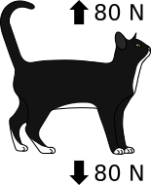
Forces are vectors.
This means that they have magnitude and direction. When we add and subtract forces, we need to think about which direction they point.
This is easy when forces act along a straight line.

Slide 5
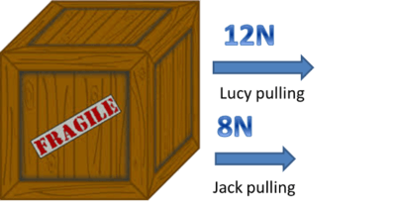
If the forces point in the same direction, we add the magnitudes.
The net force points in the same direction as the two individual forces.
Example 1: The net force acting on the box is 20 N to the right.

Slide 6
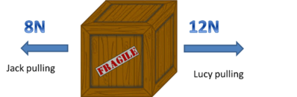
When the forces point in opposite directions, we must subtract their magnitudes.
The direction of the net force is in the direction of the larger of the two forces.
Example 2: The net force acting on the box is 4 N to the right.

